Slide 1

22ECAC210
Exploratory Data Analysis Course Project: Phase - 3 Review
Equity in Healthcare: Tackling the differences between socio-economic aspects and health equity
Department of Computer Science and Engineering,
KLE Technological University’s Dr. M. S. Sheshgiri College of Engineering and Technology, Belagavi

Slide 2
Details of the Team
Team No. |  | EDA-D3
Div: |  | D
Sl. No. | Name |  | SRN.
1 | Soham Mali |  | 02FE22BCI025
2 | Manish Sabnis |  | 02FE22BCI026
3 | Snehal Gujjar |  | 02FE22BCI046
4 | Shreya Rokade |  | 02FE22BCI042
Department of Computer Science and Engineering,
KLE Technological University’s Dr. M. S. Sheshgiri College of Engineering and Technology, Belagavi

Slide 3
Motivation: The Motivational Factors are 1.Human Rights and Dignity 2.Economic benefit 3.Social Stability and Development 4.Global Health Security 5.Sustainable Development 6.Innovation and Progress
Our project falls in the SDG3 i.e., Good Health and Well-being SDG.
The SDG3 is one of the 17 goals established by the United Nations in 2015 as part of the 2030 Agenda for Sustainable Development
The SDG3 aims to ensure healthy lives and promote well-being for all, at all ages
Department of Computer Science and Engineering,
KLE Technological University’s Dr. M. S. Sheshgiri College of Engineering and Technology, Belagavi

Slide 4
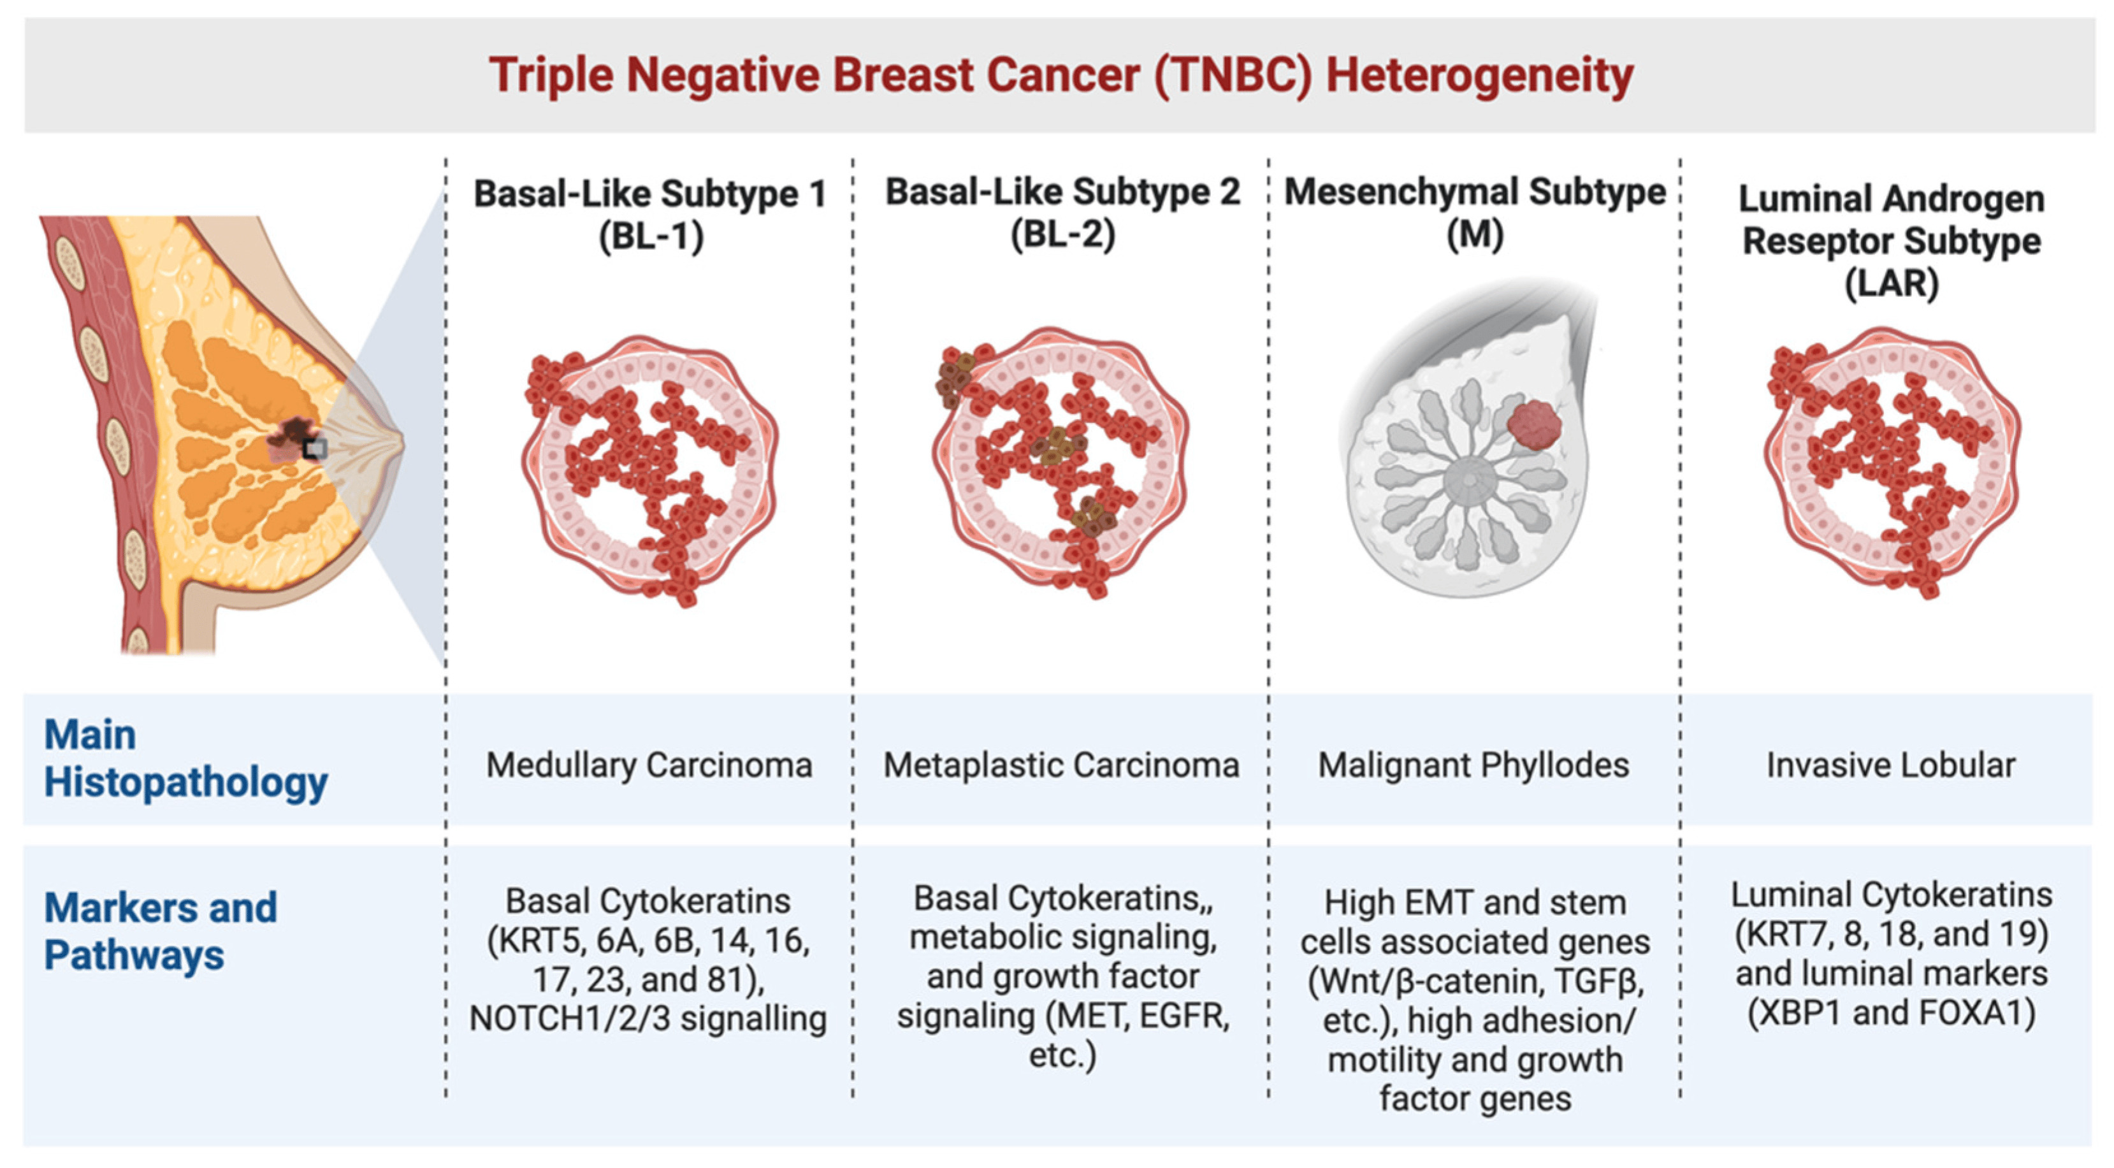
Background
Problem Statement
Given a patient’s socioeconomic and demographic details, build a predictive model that can accurately predict the time it takes for the patient to get a diagnosis of the metastasis of the TNBC. Find the relationship of the diagnosis period with the zip code-level climate patterns. Find if any biases played a role in getting the patient her quick diagnosis and timely treatment.
Department of Computer Science and Engineering,
KLE Technological University’s Dr. M. S. Sheshgiri College of Engineering and Technology, Belagavi

Slide 5
Dataset Details
A training and test set of about 19k records, representing patients and their characteristics (age, race, BMI, zip code), diagnosis and treatment information (breast cancer diagnosis code, metastatic cancer diagnosis code, metastatic cancer treatments, etc.), geo-demographic data (income, education, rent, race, poverty, etc.) at the zip-code level, and climate data that links health outcomes to environmental factors are the main focus of the WiDS Datathon 2024. Each patient and her diagnosis period are represented by a row in the data. It is your responsibility to forecast the patient's Metastatic Diagnosis Period in the Test Dataset based on the attributes and details supplied. Some data might not be as clean as data from the real world.
The WiDS Datathon 2024 focuses on a prediction task using a roughly 19k record dataset (split into training and test sets) representing patients and their characteristics (age, race, BMI, zip code), their diagnosis and treatment information (breast cancer diagnosis code, metastatic cancer diagnosis code, metastatic cancer treatments etc.), their geo (zip-code level) demographic data (income, education, rent, race, poverty etc), as well as climate data that tie health outcomes to external conditions. Each row in the data corresponds to a single patient and her Diagnosis Period. Our task is to predict the patient's Metastatic Diagnosis Period in the Test Dataset using the provided characteristics and information about the patient. Some data may be messy to reflect real-world data. Our expectation is that we will address messy data issues through appropriate means.
Source URL:
https://www.kaggle.com/competitions/widsdatathon2024
Department of Computer Science and Engineering,
KLE Technological University’s Dr. M. S. Sheshgiri College of Engineering and Technology, Belagavi

Slide 6
Knowing the Dataset
Our Dataset is split into the Train Dataset and the Test Dataset.
1. Train Dataset
• The Train dataset consists of 13173 entries with 152 attributes.
• The data types are float64 (137 columns), int64 (4 columns), and object (11 columns).
• The memory size is 15.3 MB
2. Test Dataset
• The Test dataset consists of 5646 entries with 151 attributes.
• The data types are float64(137 columns), int64 (3 columns), and object(11 columns).
• The memory size is 6.5 MB
Department of Computer Science and Engineering,
KLE Technological University’s Dr. M. S. Sheshgiri College of Engineering and Technology, Belagavi

Slide 7
Empathy
Impacts of Ill Health:
The impacts of ill health on individuals and society are intense and sophisticated.
The individuals suffering from TNBC, due to poor health can lead to diminished quality of life, which increases medical expenses.
This will further result in Financial stress and loss of income due to inability to work.
From a Societal perspective Ill health can burden health care systems, leading to higher national healthcare costs.
Overall the common effects of ill health underscore the importance of robust public health initiatives and access to quality health care for all.
Department of Computer Science and Engineering,
KLE Technological University’s Dr. M. S. Sheshgiri College of Engineering and Technology, Belagavi

Slide 8
Proposed Hypothesis
Given that patients are mostly ordinary people, the fact that the commercial payer type is dominant in the dataset indicates that most patients prefer private insurance, indicating that most patients are predominantly ordinary people who do not enjoy any government benefits.
Department of Computer Science and Engineering,
KLE Technological University’s Dr. M. S. Sheshgiri College of Engineering and Technology, Belagavi

Slide 9
Proposed Hypothesis
1.Why so? How can you prove it?
2. How can you prove that insurance played a role in determining the diagnosis period?
3. So who are these patients?
4. Does that mean that the patients were uneducated or perhaps not from the USA?
5. What else indicates that the patients were not from USA?
6. Could there be a possibility that the dataset is biased?
7. How was the dependence of the diagnosis period on the patients health?
8. So in terms of patient's health, what contributed to the diagnosis period?
Department of Computer Science and Engineering,
KLE Technological University’s Dr. M. S. Sheshgiri College of Engineering and Technology, Belagavi

Slide 10
Proposed Hypothesis
9. Is the BMI dependent on the patient's age?
10. And what about the marital status?
11. If marital status played a role in the diagnosis period of the patient, does that mean the family size did as well?
12. So how did the people in the region of the patient affect the diagnosis period?
13. In terms of the cancers, who was responsible in the late or quick diagnosis period of the patients?
14. So their cures played a role too?
15. What else played a role in diagnosing a patient?
Department of Computer Science and Engineering,
KLE Technological University’s Dr. M. S. Sheshgiri College of Engineering and Technology, Belagavi

Slide 11
Implementation Framework
Project Research
Data Analysis
Statistical Analysis
Data Preprocessing
Univariate and Multivariate Analysis
Model Selection
Performance Analysis
Department of Computer Science and Engineering,
KLE Technological University’s Dr. M. S. Sheshgiri College of Engineering and Technology, Belagavi

Slide 12
Project Research
• Gather Domain Knowledge and Relevant Information.
• Review Literature and Existing Solutions.
• Define the Project’s Deliverables.
Department of Computer Science and Engineering,
KLE Technological University’s Dr. M. S. Sheshgiri College of Engineering and Technology, Belagavi

Slide 13
Data Analysis
Understand the Dataset to gain Insights.
• Perform initial Exploratory Data Analysis(EDA)
• Summarize Data with Descriptive Statistics.
Department of Computer Science and Engineering,
KLE Technological University’s Dr. M. S. Sheshgiri College of Engineering and Technology, Belagavi

Slide 14
Statistical Analysis
Apply Statistical Methods to understand the data patterns and relationships.
Calculation of key statistical measures (Mean, Median, Standard Deviation, Correlation)
Conduct Hypothesis test to Validate Assumptions.
Department of Computer Science and Engineering,
KLE Technological University’s Dr. M. S. Sheshgiri College of Engineering and Technology, Belagavi

Slide 15
Data Preprocessing
Data Preprocessing is a crucial step that needs to be performed in Data Analysis. It involves Cleaning, Transforming, and Organizing Raw data into a suitable format.
We carried out various Data Pre processing steps presented in next slide:
Department of Computer Science and Engineering,
KLE Technological University’s Dr. M. S. Sheshgiri College of Engineering and Technology, Belagavi

Slide 16
Data Preprocessing
NLP-based Replacement: Here we have used Natural Language Processing (NLP) Techniques to replace any incorrect descriptions and their equivalent cancer codes with female cancer descriptions and respective cancer codes from the ICD10 website.
Imputation with Mean: Here we imputed Missing Values with Mean. By imputing with mean values we notice that the BMI column exploded. So, Now we try imputing values with KNN imputation and apply the same for categorical columns.
Department of Computer Science and Engineering,
KLE Technological University’s Dr. M. S. Sheshgiri College of Engineering and Technology, Belagavi

Slide 17
Data Preprocessing
LOFO(Leave One Feature Out) calculates the importance of features and guides us in deciding which column to drop. We used LOFO importance to calculate important columns and dropped the columns that had a negative importance Mean score.
We capped the outliers with extreme values in the dataset that can skew the model performance. By capping the outliers the extreme values will fall within a suitable range which in turn will improve the Reliability and Accuracy of our Model.
We Compared the skewness of the columns before capping the outliers and after capping the outliers. There was no significant change in the values which determines that the outliers are not heavily influencing the overall distribution of the Dataset.
Department of Computer Science and Engineering,
KLE Technological University’s Dr. M. S. Sheshgiri College of Engineering and Technology, Belagavi

Slide 18
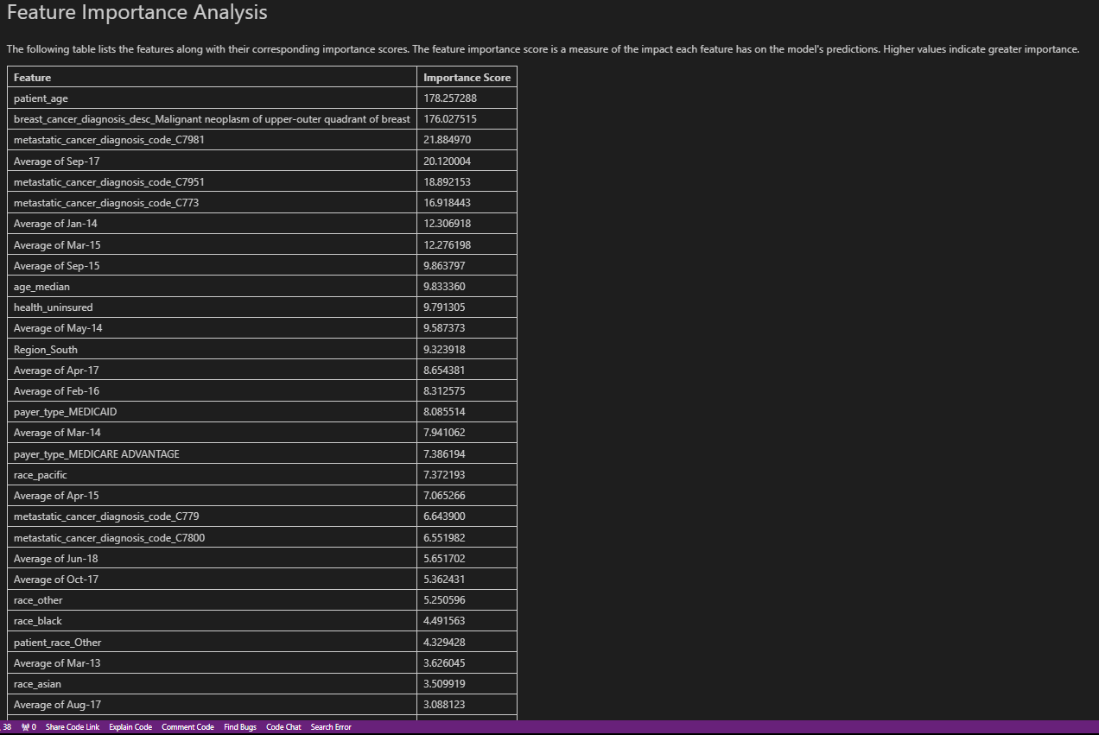
Data Preprocessing LOFO Model
Department of Computer Science and Engineering,
KLE Technological University’s Dr. M. S. Sheshgiri College of Engineering and Technology, Belagavi

Slide 19
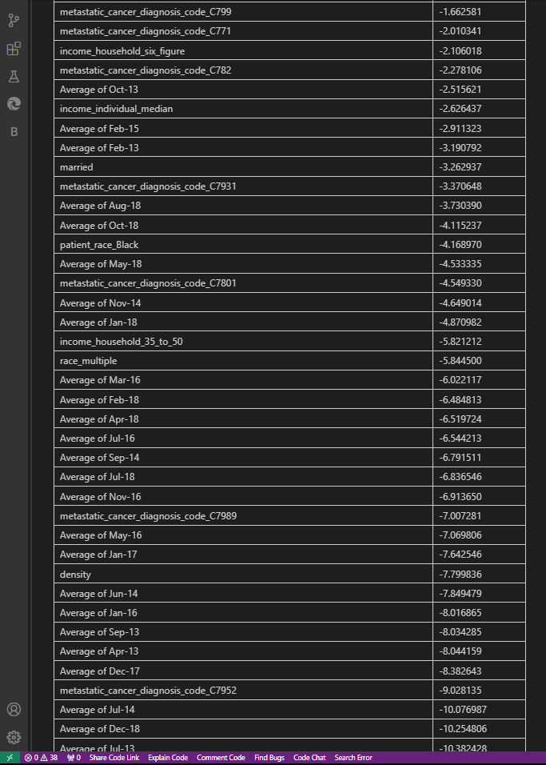
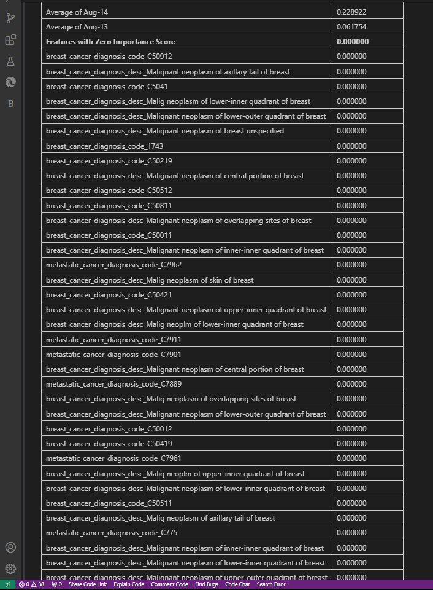
Data Preprocessing LOFO Model
Department of Computer Science and Engineering,
KLE Technological University’s Dr. M. S. Sheshgiri College of Engineering and Technology, Belagavi

Slide 20
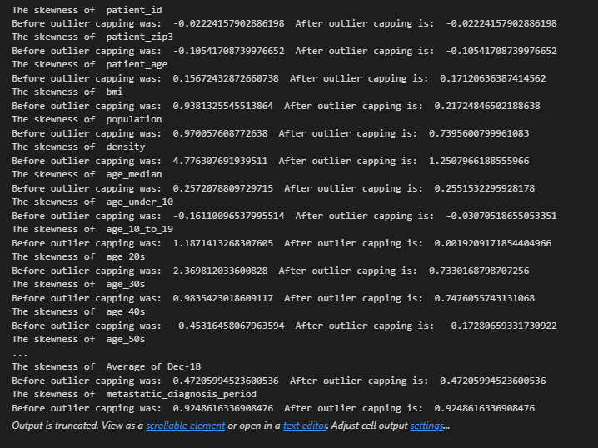
Data Preprocessing Capping Outliers
Department of Computer Science and Engineering,
KLE Technological University’s Dr. M. S. Sheshgiri College of Engineering and Technology, Belagavi

Slide 21
Univariate and Multivariate Analysis
Examining the data in depth and understanding the relationships between variables.
Conduct Univariate Analysis to understand individual variable distributions.
Conduct Multivariate analysis to explore Interactions and Correlations between multiple variables.
Department of Computer Science and Engineering,
KLE Technological University’s Dr. M. S. Sheshgiri College of Engineering and Technology, Belagavi

Slide 22
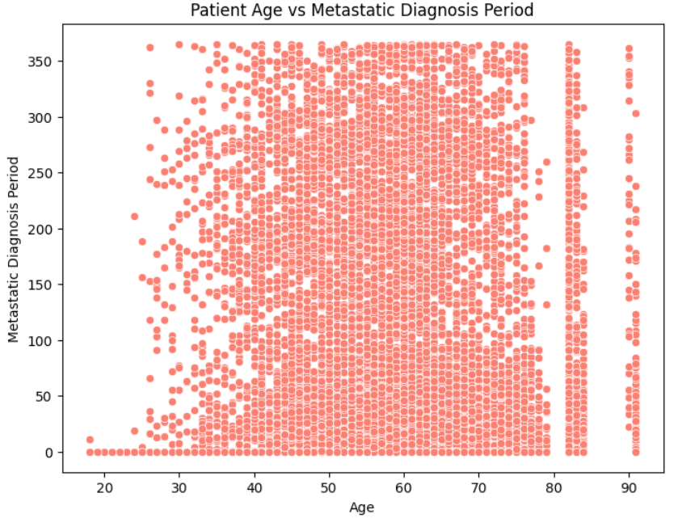
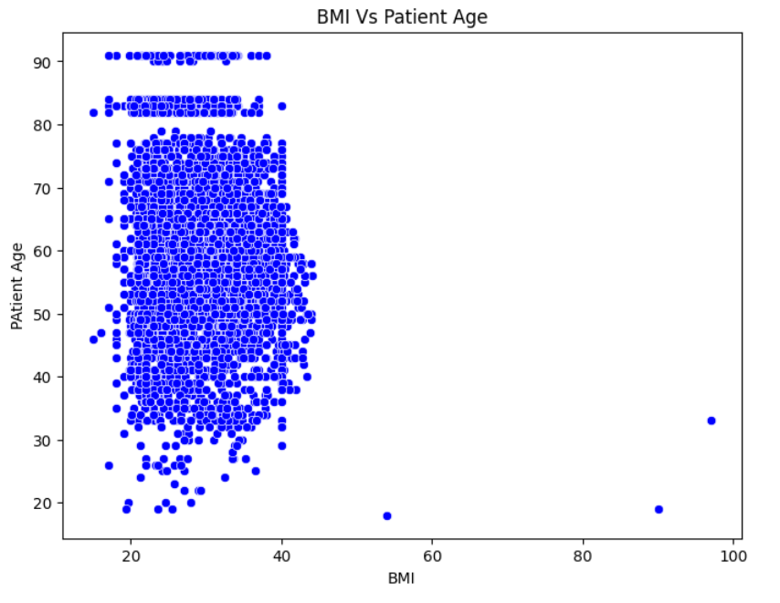
Plots for Reference
Department of Computer Science and Engineering,
KLE Technological University’s Dr. M. S. Sheshgiri College of Engineering and Technology, Belagavi

Slide 23
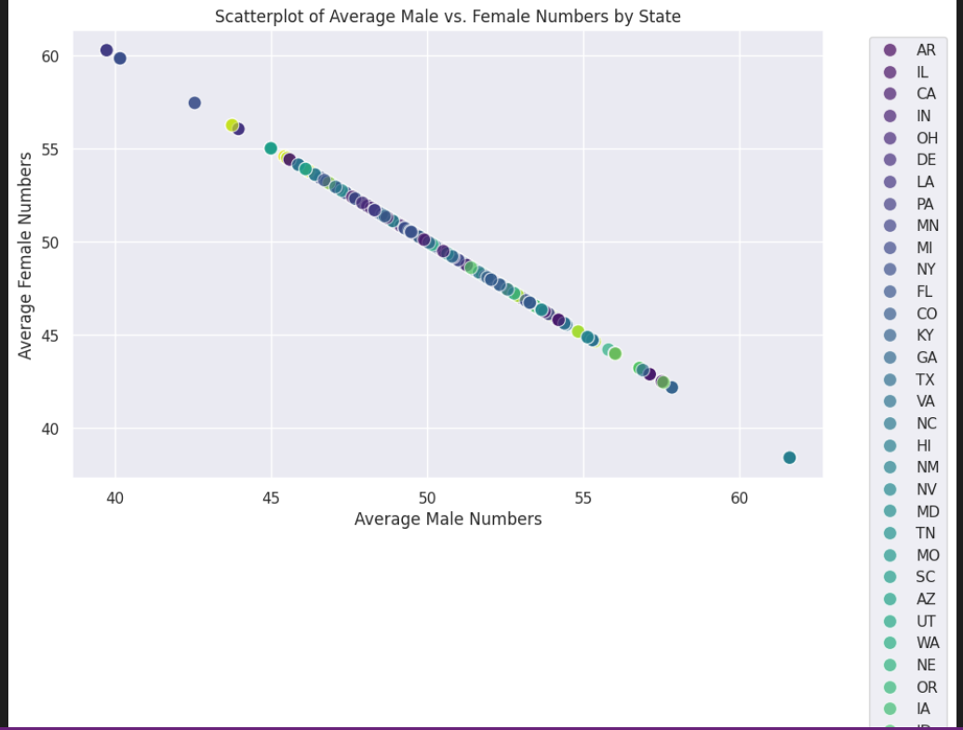
Plots for Reference
Department of Computer Science and Engineering,
KLE Technological University’s Dr. M. S. Sheshgiri College of Engineering and Technology, Belagavi

Slide 24
Model Selection
We performed Multiple Regression to find the best fitting model, Evaluated the models based on R-squared analysis and rejected insignificant attributes based on their p-value.
We used OLS model, LOFO model and various kinds of Regression methods.
Department of Computer Science and Engineering,
KLE Technological University’s Dr. M. S. Sheshgiri College of Engineering and Technology, Belagavi

Slide 25
OLS model
We notice that there are columns with p-value more than 0.05. This explains us that these columns add explanatory power to the data but makes the regression model incapable of producing useful results. So dropping these columns can be a good strategy which can maximize the R-square by better fitting model to our data. So all columns with p value more than 0.05 are excluded.
We see that upon excluding the columns that exceeded a p-value of 0.05, the R-square value of the model significantly decreases to the point where it almost has no predictive power and cannot explain the dependence of the dependent variable on the present independent variable.
This could be due to the underlying factor that even though the excluded variable has a greater p-value, they had some relation with the dependent variable "metastatic_diagnosis_period". Hence implementing this strategy of Excluding these variable is not feasible.
Therefore, we have not excluded any column.
Department of Computer Science and Engineering,
KLE Technological University’s Dr. M. S. Sheshgiri College of Engineering and Technology, Belagavi

Slide 26
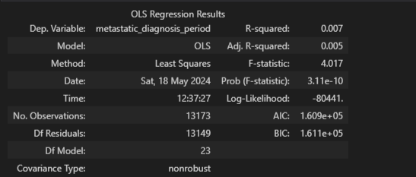
OLS model
Department of Computer Science and Engineering,
KLE Technological University’s Dr. M. S. Sheshgiri College of Engineering and Technology, Belagavi

Slide 27
LOFO (Leave One Feature Out) model
We used LOFO model for Feature Importance Analysis and it guided us in which column to be dropped and which one to be retained.
Conclusions Drawn from this Model:
The breast_cancer_diagnosis_descriptions show a higher LOFO importance score indicating a higher correlation with the target variable
Temperatures did have an effect on the target variable. LOFO importance model shows a higher importance mean for temperatures of certain months in certain years.
Department of Computer Science and Engineering,
KLE Technological University’s Dr. M. S. Sheshgiri College of Engineering and Technology, Belagavi

Slide 28
LOFO (Leave One Feature Out) model
The "payer_type" influenced the target variable as shown by LOFO importance which could mean that with better insurance payment methods, patients may have skipped some tests or maybe took them.
LOFO Importance show negative importance mean for farmer columns which means that areas with farming population did not influence the target variable
Average Of Jan-14 and Average of Mar-15 show equal LOFO importance score meaning that they may have a collective effect on the target variable Strong relationship between patient age and target variable as shown by LOFO importance model.
Education Bachelors has a higher correlation with the target variable as shown by LOFO importance which could be true as patients with a knowledge of what testing they are going through may choose to skip some tests as they deem it to be unworthy.
Department of Computer Science and Engineering,
KLE Technological University’s Dr. M. S. Sheshgiri College of Engineering and Technology, Belagavi

Slide 29
Regression:
We have applied Linear Regression, Ridge Regression, Lasso Regression, Decision Tree Regressor, K-Neighbour Regressor, Histogram Based Gradient Boosting Regressor.
From this Analysis we choose the least RMSE model for the test data frame and came to a conclusion that Histogram based Gradient Boosting Regression is the best model that can be applied to our data.
Department of Computer Science and Engineering,
KLE Technological University’s Dr. M. S. Sheshgiri College of Engineering and Technology, Belagavi

Slide 30
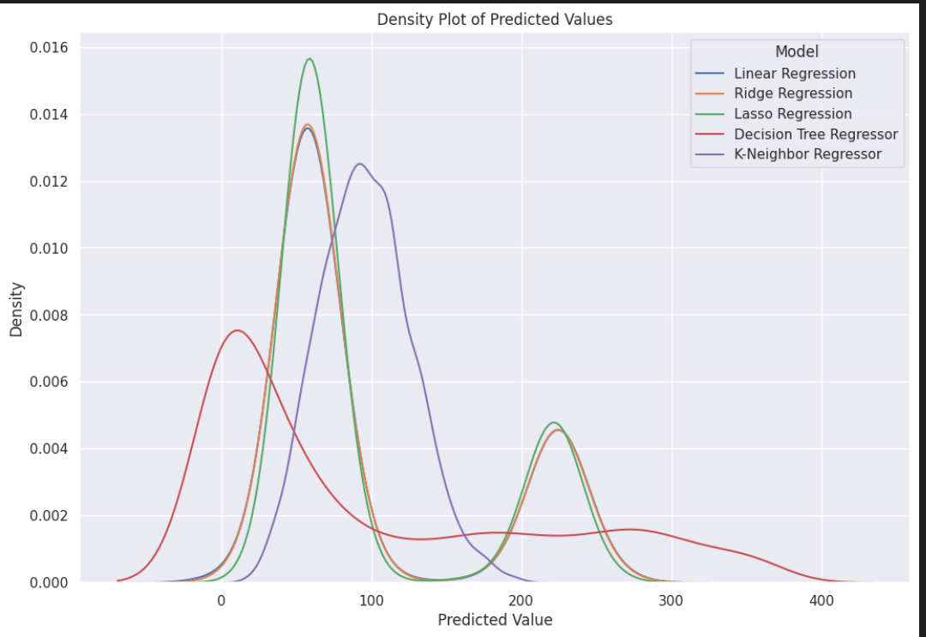
Regression Analysis:
Department of Computer Science and Engineering,
KLE Technological University’s Dr. M. S. Sheshgiri College of Engineering and Technology, Belagavi

Slide 31
Performance Analysis
We finally opted for Histogram Based Gradient Boosting Regression method for our Dataset and here our evaluation metric parameter was Root Mean Square Error (RMSE).
We tried with both ways where first we tried with Preprocessed dataset and then without Preprocessed
On applying the Preprocessed dataset the RMSE recorded around 107.35
So again, we applied Histogram based Gradient boosting method on the train and test datasets without any Preprocessing and now the RMSE recorded was 81.887 which was quite better from the previous case.
Therefore we applied this Regression method for our model and got the results.
Department of Computer Science and Engineering,
KLE Technological University’s Dr. M. S. Sheshgiri College of Engineering and Technology, Belagavi

Slide 32
Implementation Flow
Project Research
Data Analysis
Statistical Analysis
Data Preprocessing
Performance Analysis
Model Selection
Univariate and Multivariate Analysis
Department of Computer Science and Engineering,
KLE Technological University’s Dr. M. S. Sheshgiri College of Engineering and Technology, Belagavi

Slide 33
MOOC Course Details
Team No. : EDA-D3
Div: D
Sl. No. | Name | SRN. | Course Name | Course Link | Status
1 | Soham Mali | 02FE22BCI025 | Python 101 for Data Science | https://courses.cognitiveclass.ai/certificates/c4707266f46a4323b86e79b593d69046 | Completed
2 | Manish Sabnis | 02FE22BCI026 | Complete Data Science Boot camp | https://www.udemy.com/course/the-data-science-course-complete-data-science-bootcamp/?couponCode=LETSLEARNNOWPP | Completed
Department of Computer Science and Engineering,
KLE Technological University’s Dr. M. S. Sheshgiri College of Engineering and Technology, Belagavi

Slide 34
MOOC Course Details
Team No. : EDA-D3
Div: D
Sl. No. | Name | SRN. | Course Name | Course Link | Status
3 | Snehal Gujjar | 02FE22BCI046 | Python for Data Science | https://www.udemy.com/course/python-data-science-master-course/?couponCode=LETSLEARNNOWPP | Completed
4 | Shreya Rokade | 02FE22BCI042 | Python for Data Science | https://www.udemy.com/course/python-data-science-master-course/?couponCode=LETSLEARNNOWPP | Completed
Department of Computer Science and Engineering,
KLE Technological University’s Dr. M. S. Sheshgiri College of Engineering and Technology, Belagavi

Slide 35
Thank you !
Questions and Answers
Department of Computer Science and Engineering,
KLE Technological University’s Dr. M. S. Sheshgiri College of Engineering and Technology, Belagavi

